Slide 1
Group 1 Project Updates
Stat 6080 Data Technologies
Nov 11, 2021

Slide 2
Task Leads
Ragan Astle (Group Leader):
Graphics Lead
Latex Document Lead
McKade Thomas
Report Lead
Nate Nellis
Data Analyst Lead
Tyler Antoloci
Latex Beamer Lead
Web Scrape Lead

Slide 3

Ad Information
Store Chain: Commissary Hill
Most recent ad available in PDF format on Commissary website
Weekly Ads website has ads since 2018 in image format
https://weekly-ads.us/hill/commissary/7541-6th-st

Slide 4
Progress Update
Automated scraping/sampling:
After initial success using a workaround in Python, we ran into further troubles with too many API calls (resulting in the webpage blocking our IP address).
The website allows access again after a few hours, so a final attempt will be made to scrape the page by pausing the loop after each run. If this attempt is unsuccessful, we will resort fully to OCR/working with a sample the image files.
OCR optimization:
Investigating use of image cropping
Found a few optimal OCR methods, image_modulate(), image_noise()

Slide 5
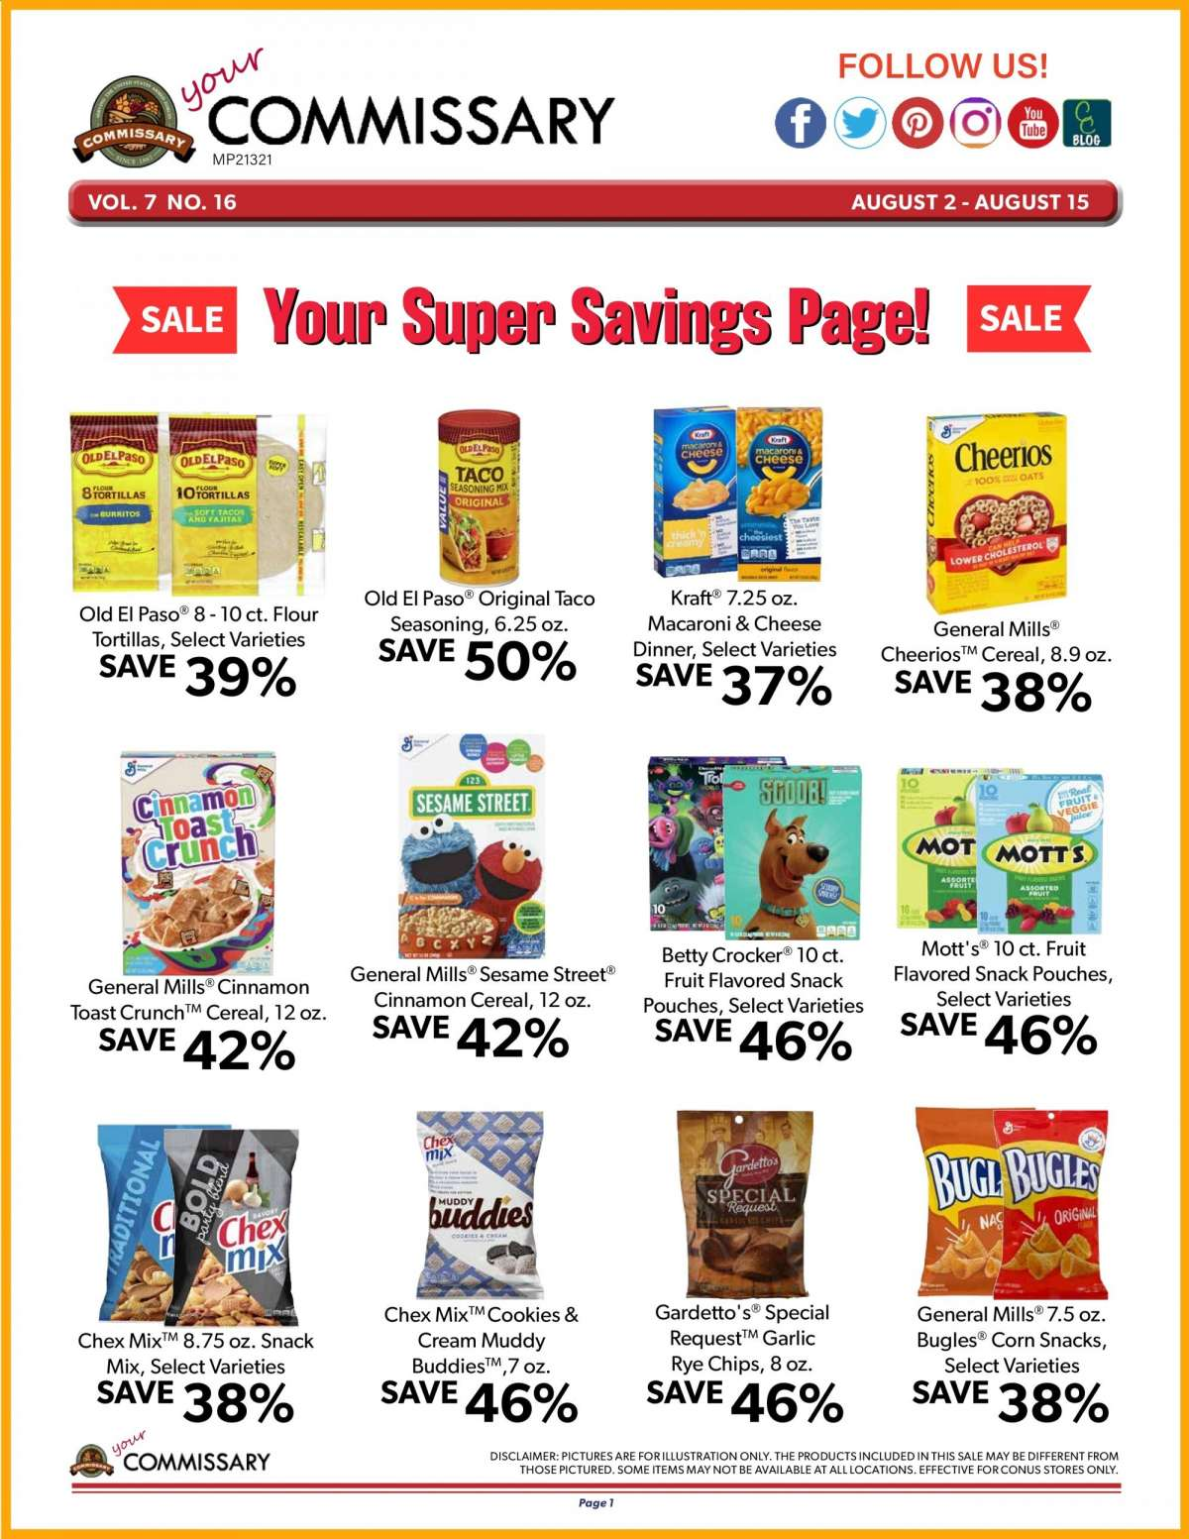
Image Cropping Example
EDUCED SF, col REY: ; Cheerios
Bigtruas — 10FBRns psoas GH Fee , ie om
aaa . = S EB
ol |g | Ei | acre
sae sn | j ee 5 bie
Old El Paso® 8-10 ct: Flour Old El Paso® Original Taco Kraft® 7.25 oz. =
; “ ee Seasoning, 6.25 oz. Macaroni & Cheese General Mills®
‘SAVE 390, SAVE 50% SAVE >: or Cheerios™ Cereal, 8.9 oz.
SAVE °
° 37% 38%
d=
are bd in wee
ewan} SST = of Na.
Where did the “Tortillas, Select Varieties” go?

Slide 6
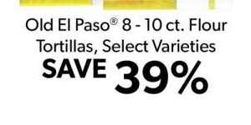
Image Cropping Example
a1 <- image_crop(ad_test, geometry = geometry_area(width = 300,
height = 150,
x_off = 50,
y_off = 590))
text_a1 <- ocr(a1)
cat(text_a1)
Old El Paso® 8 - 10 ct. Flour
Tortillas, Select Varieties
SAVE 9
39%

Slide 7
Current Challenges
Webpage blocks our IP address for several hours after scraping attempt.
Image cropping has proved difficult (but not impossible) due to the inconsistency between ad pages.

Slide 8
Moving Forward
Attempt to scrape the webpage a final time by pausing the system in between iterations.
If this fails, grab a sample of image files from October – December of each year.
Look at holiday trends
Improve image cropping to locate correct elements of the image files.

Slide 9
Questions?

